Slide 1
期末project

Slide 2
評分標準
GEM5 + NVMAIN BUILD-UP (40%)
Enable L3 last level cache in GEM5 + NVMAIN (15%)
Config last level cache to 2-way and full-way associative cache and test performance (15%)
Modify last level cache policy based on RRIP (15%)
Test the performance of write back and write through policy based on 4-way associative cache with isscc_pcm(15%)
Bonus (20%)
Design last level cache policy to reduce the energy consumption of pcm_based main memory
Baseline:LRU

Slide 3
Nvmain+gem5教學

Slide 4
Virtual machine
推薦使用Ubuntu 18.04
Ubuntu 20.04 g++太新 nvmain編譯會出問題
Ubuntu 16.04 gem5不支援

Slide 5
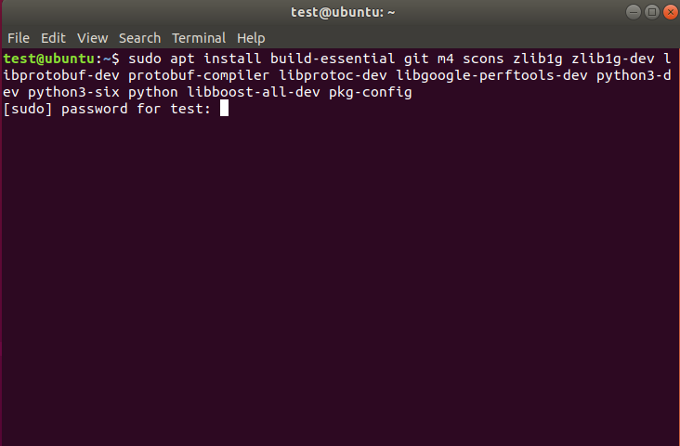
安裝編譯工具
sudo apt install build-essential git m4 scons zlib1g zlib1g-dev libprotobuf-dev protobuf-compiler libprotoc-dev libgoogle-perftools-dev python3-dev python3-six python libboost-all-dev pkg-config

Slide 6
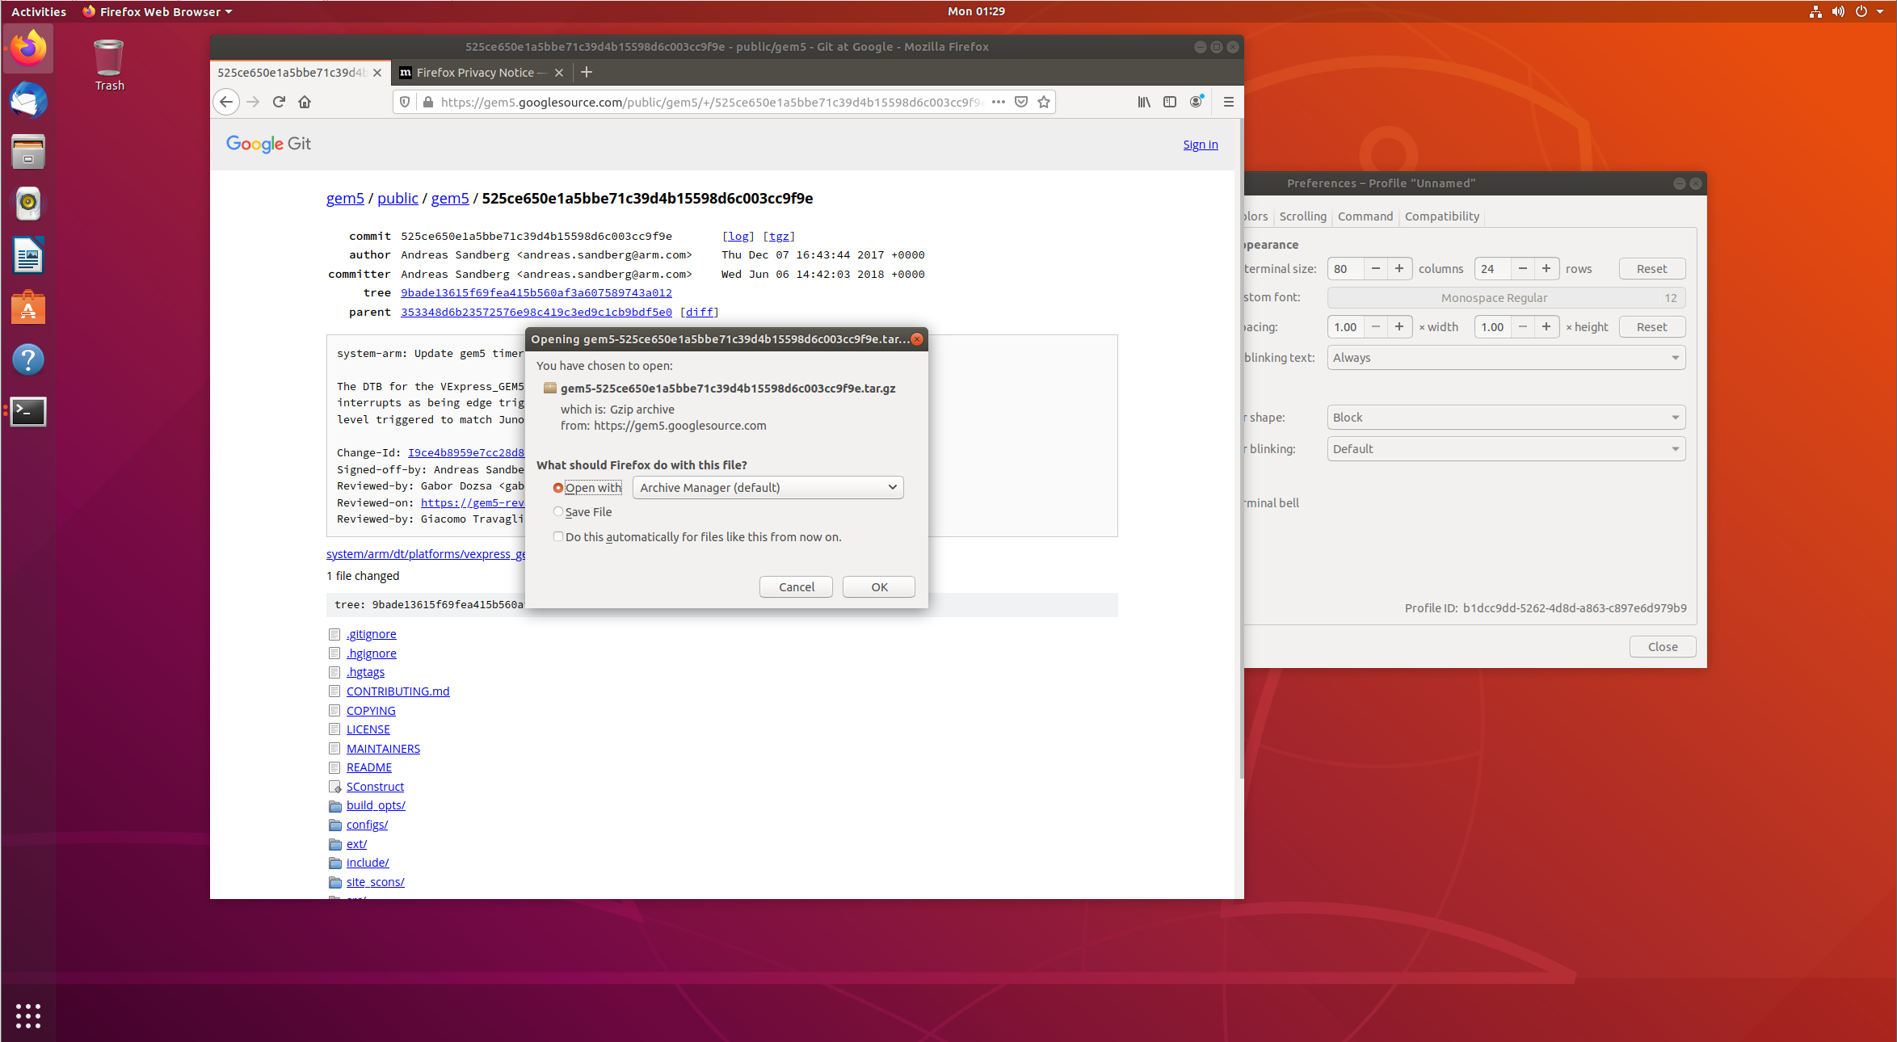
安裝gem5
https://gem5.googlesource.com/public/gem5/+/525ce650e1a5bbe71c39d4b15598d6c003cc9f9e
點tgz下載(不推薦下載最新版的GEM5，後面編譯會出問題)

Slide 7
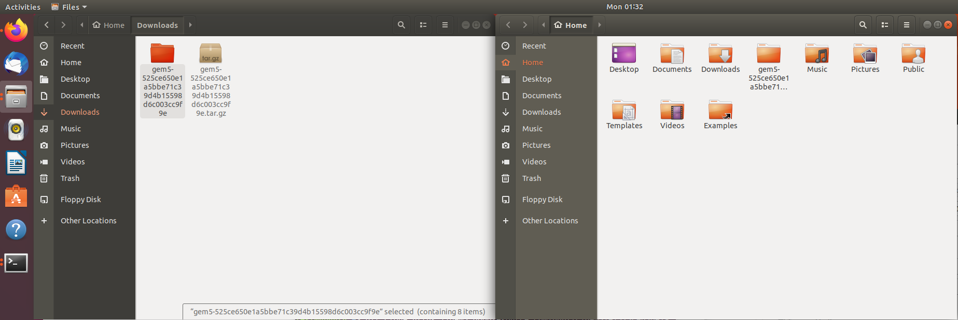
把解壓後的GEM5資料夾丟進HOME

Slide 8
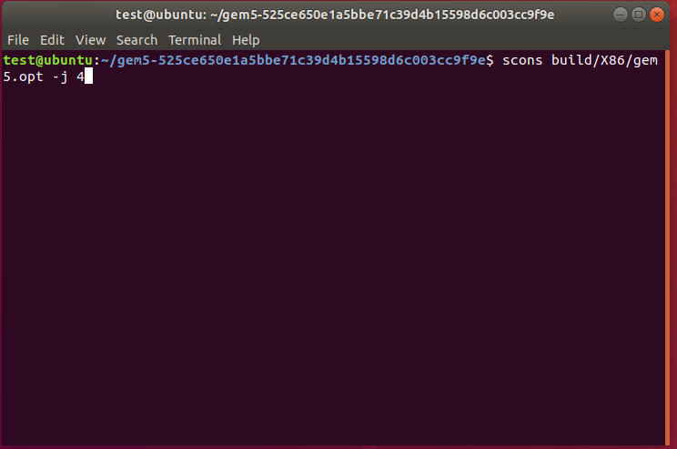
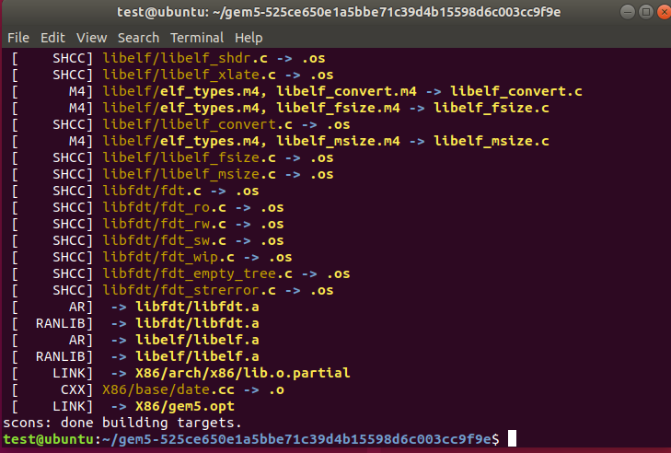
編譯 GEM5
在GEM5目錄下scons build/X86/gem5.opt (後面可以加 –j num num為multithread數量來加速)
這安裝要大概20分鐘

Slide 9
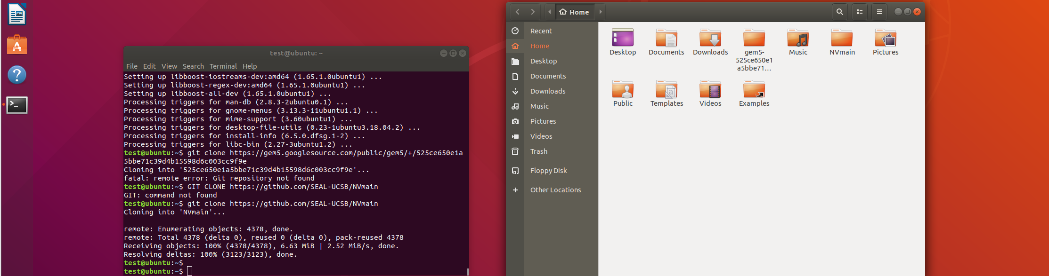
用GIT 安裝 NVMAIN
git clone https://github.com/SEAL-UCSB/NVmain
把nvmain跟gem5放到同一個目錄下

Slide 10
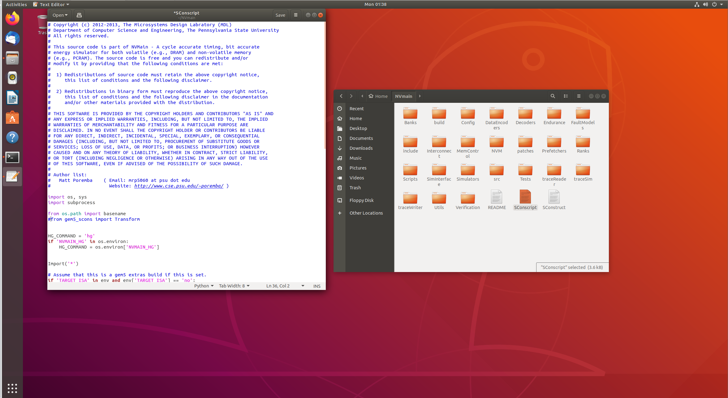
修改 sconscript
進入nvmain資料夾 點開 SConscript 把36行的from gem5_scons import Transform註解掉(記得要存檔)

Slide 11
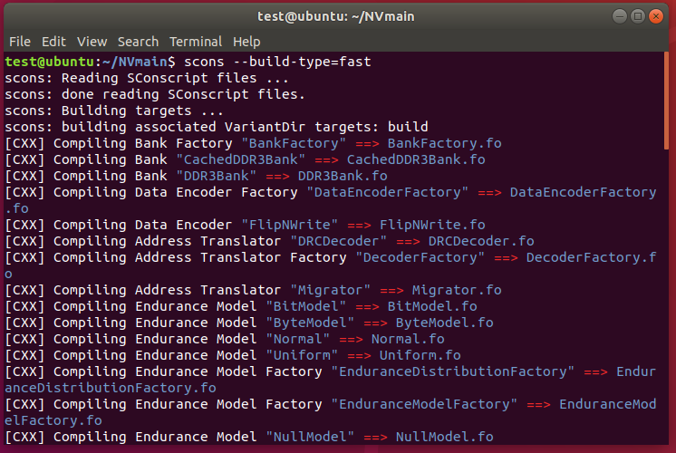
編譯nvmain
在NVmain目錄下 scons --build-type=fast

Slide 12
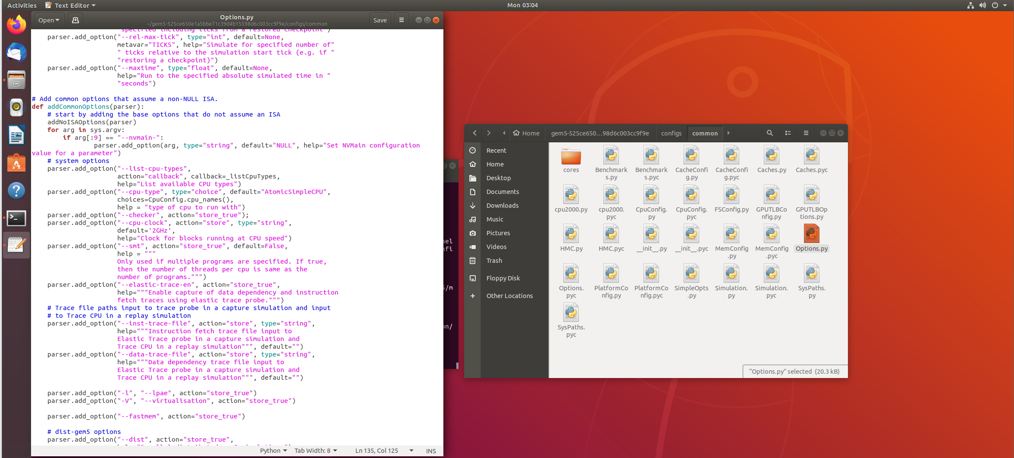
修改gem5 options
在gem5/configs/common/Options.py中第133行加入下段程式(記得要存檔)
for arg in sys.argv:
if arg[:9] == "--nvmain-":
parser.add_option(arg, type="string", default="NULL", help="Set NVMain configuration value for a parameter")

Slide 13
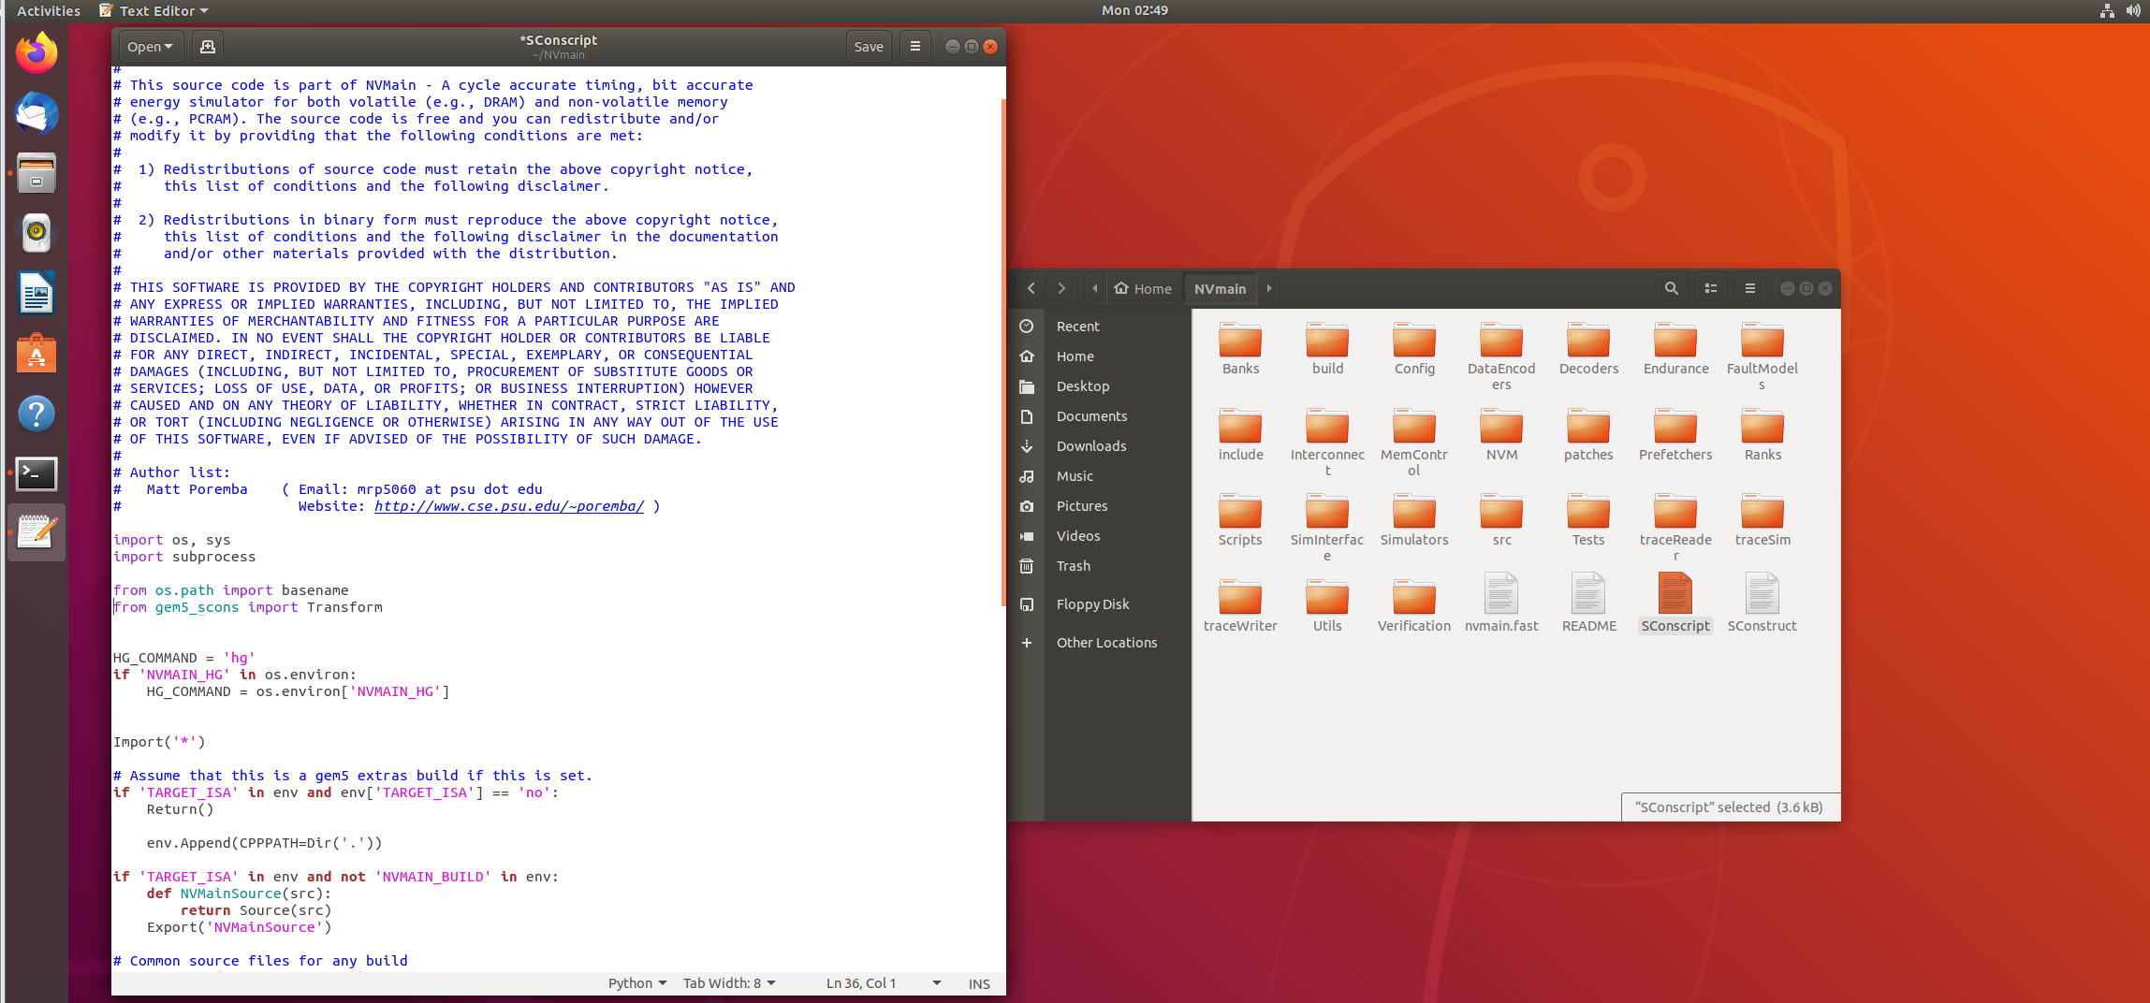
還原 sconscript
還原前面nvmain sconscript註解掉的指令

Slide 14
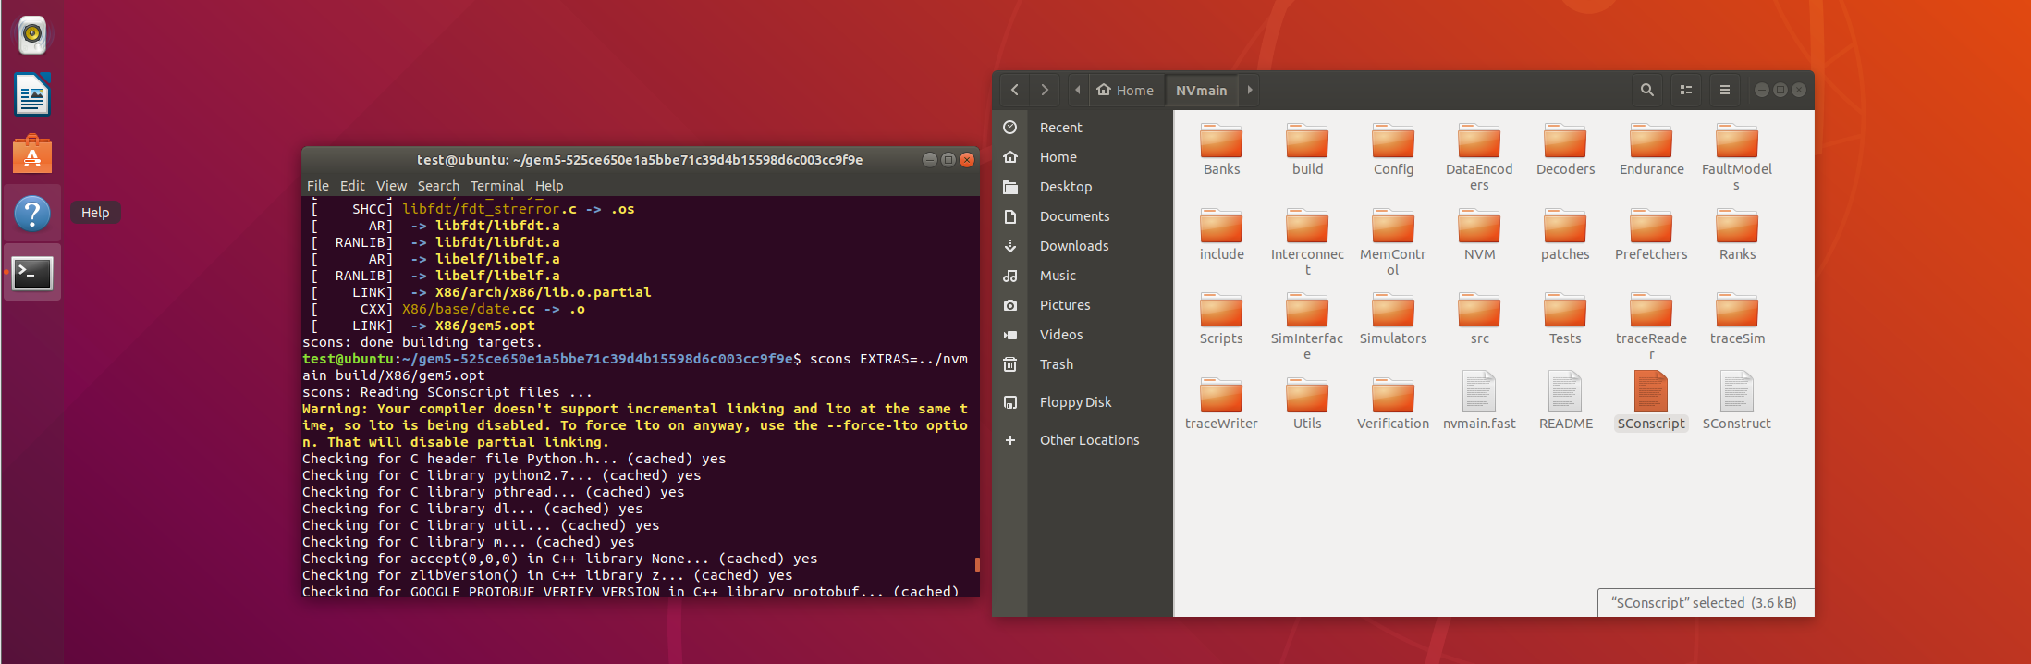
混和編譯 gem5
在GEM5目錄下 混合NVMAIN編譯GEM5
scons EXTRAS=../NVmain build/X86/gem5.opt

Slide 15
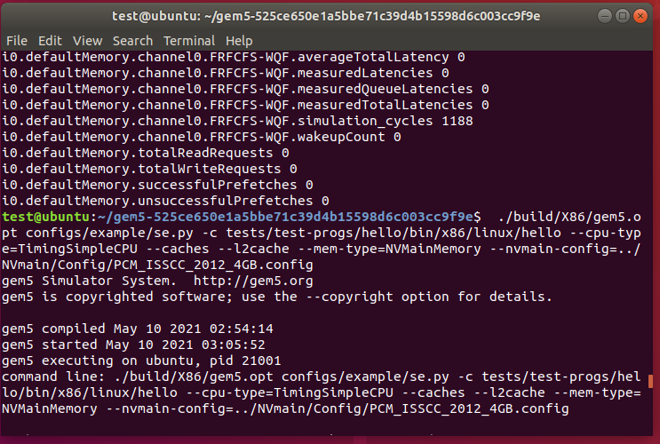
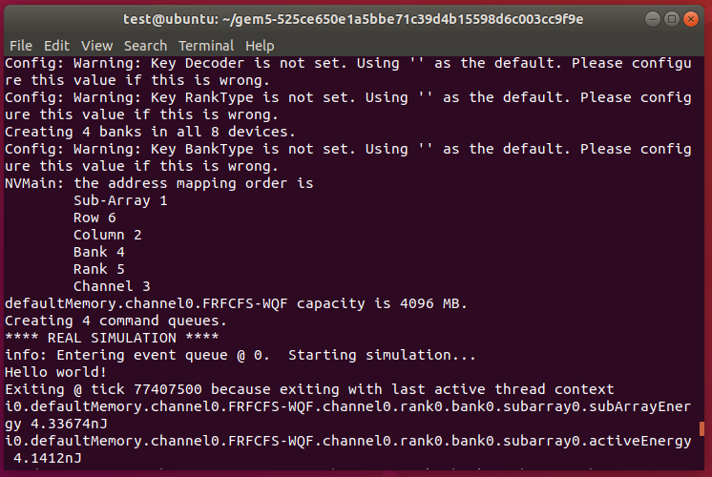
測試HELLO WORLD
Gem5 執行檔
程式執行檔
./build/X86/gem5.opt configs/example/se.py -c tests/test-progs/hello/bin/x86/linux/hello --cpu-type=TimingSimpleCPU --caches --l2cache --mem-type=NVMainMemory --nvmain-config=../NVmain/Config/PCM_ISSCC_2012_4GB.config
nvm
Hello world!

Slide 16
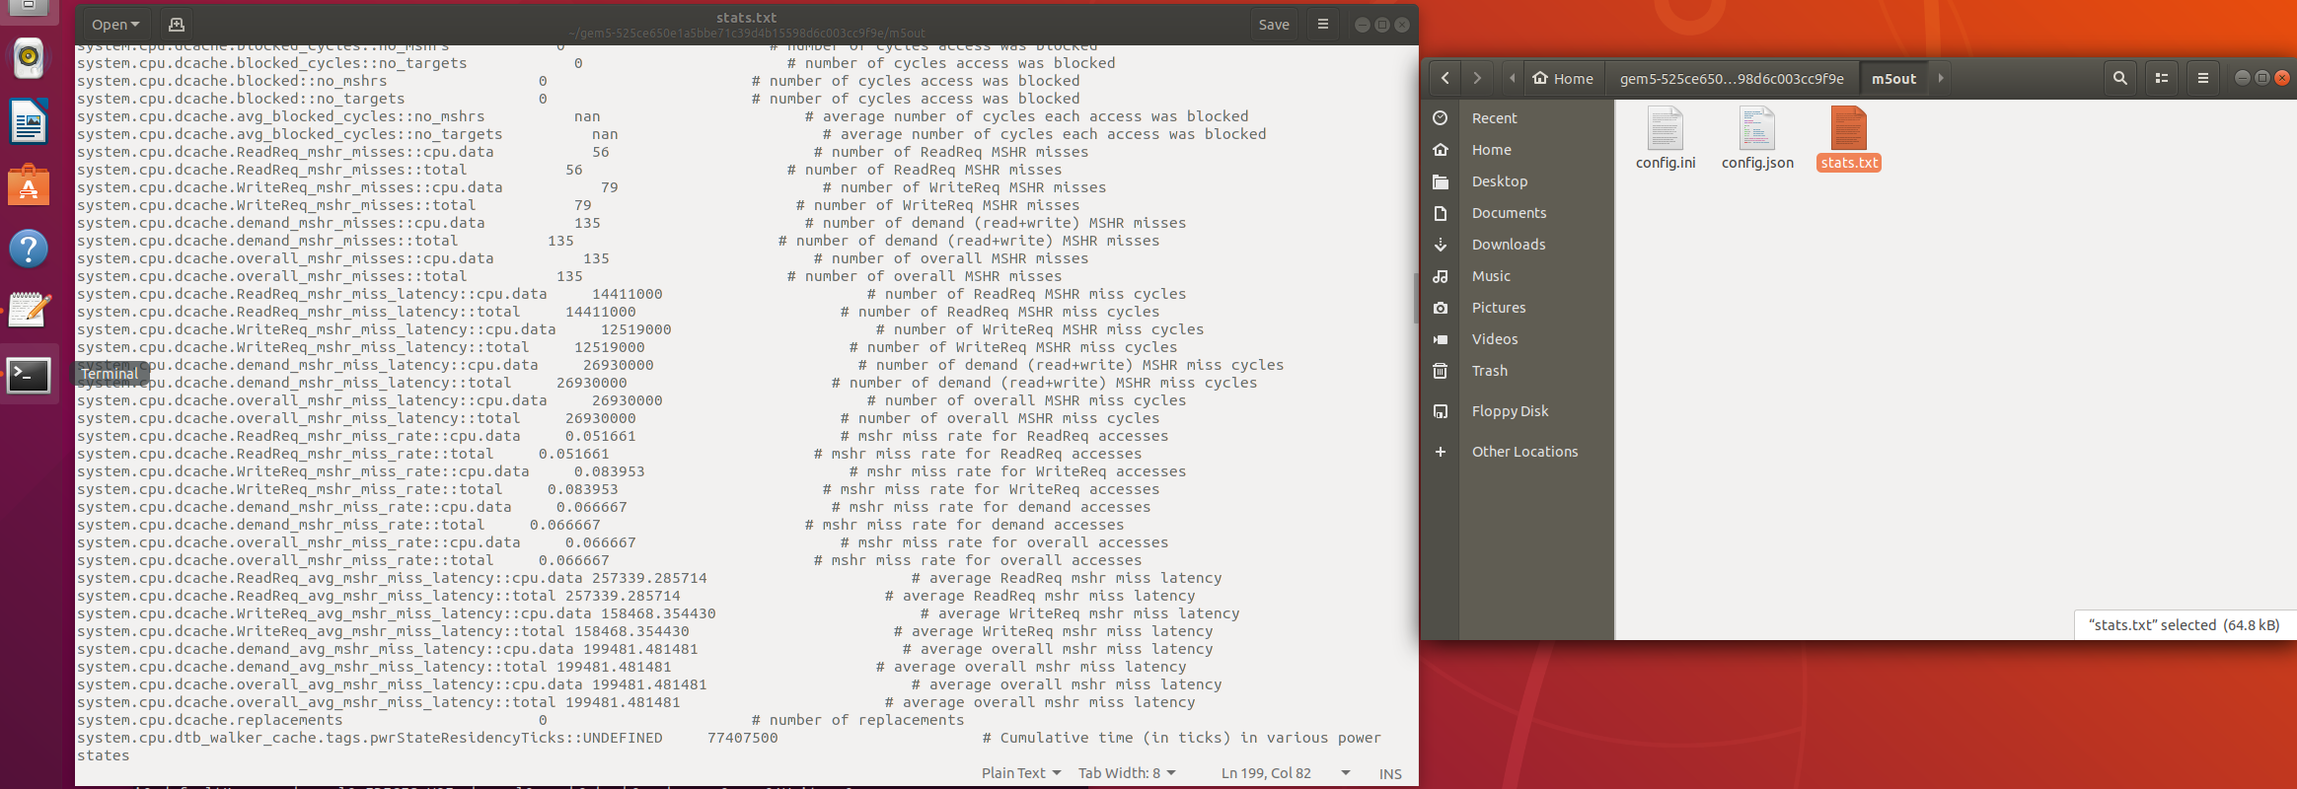
output
可以由gem5/m5out中的stat.txt查看cache hit 的次數

Slide 17
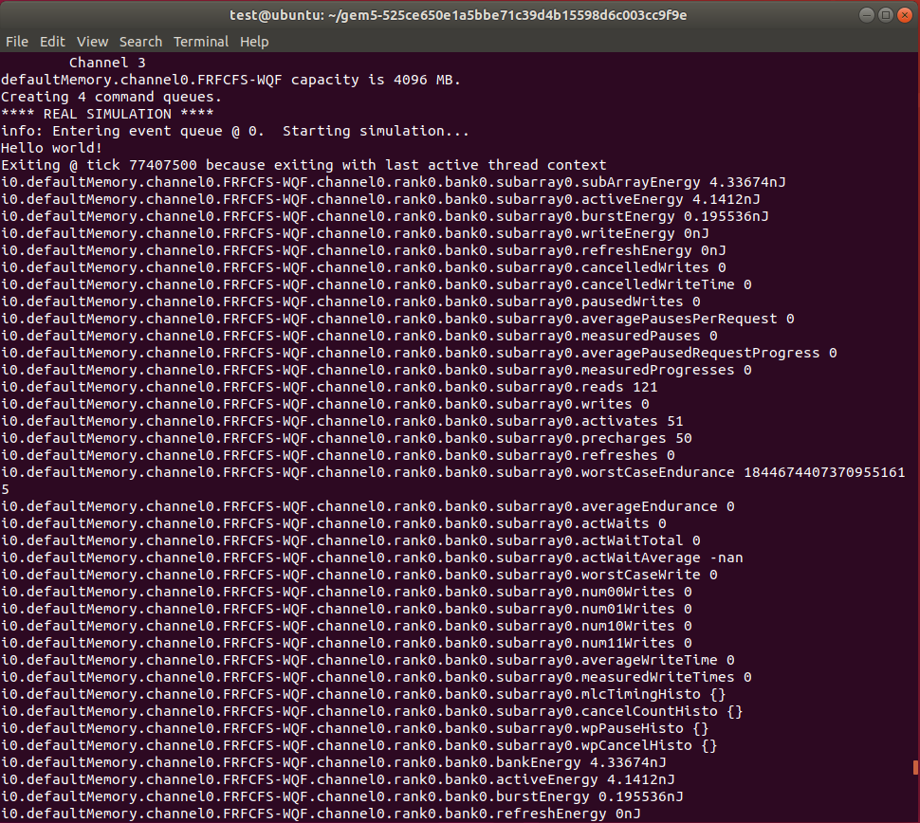
Active energy
在執行完程式後就可以看到

